Slide 1

Project Title – Car Market Trend Analysis
Dhruv

Slide 2
Work done
Reading & cleaning of data and formatting it properly.
Finding the total count of brand which brand has more demand in resale market.
How many cars have been sold respected to their brand.
Which are the top five used car sold in the market and how many units are sold
How many car has been sold with respect to fuel type.
How many seller type are selling car in CarDekho.
Comparing the selling price of car with respect to its actual cost and vehicle age .
Which cars has maximum and minimum mileage.
Which car is best in seating range.
How many cars have been sold according to its age.
Plotting graph using Seaborn.
Finding top used cars which is 4 years old.
Searching cars, budget from 10 thousand to 9 lakhs .
Overall view of cars in CarDekho price range from 10K to 4Cr.
Finding the correlation.
Using pair plot to show the relation between all variable.

Slide 3

Technology Used
Python , matplotlib , pandas , numpy , jyupyter notebook

Slide 4

Conclusion
Brand having more demand in resale market are: Maruti,Hyundai,Honda,Mahindra,Toyota
Car with highest count in market are: Hyundai i20
Seller Type in market: Dealer(61.9%),Individual(37.0%),Trustmark dealer(11%)
Car power to price relation as power increace the price increase
Maruti Cars has best mileage and maintainance is low
5 seater cars are in more demand than that of 7 seaters
Top three best car to buy with respect to each and every variable: a) Maruti Wagon R : Fuel type = CNG, Market price = 691769.09 Rs, Selling Price = 450000 Rs, Mileage = 33.54,Age = 4 b) Maruti Swift Dzire or Maruti Swift: Fuel type = Petrol ,Market Price = 900000 ,Selling Price = 750000 Rs ,Mileage = 28.40 ,Age = 4 c) Hyundai i20 : Fuel type = Petrol ,Market Price = 800000 ,Selling Price = 215000 , Mileage = 17 ,Age = 4

Slide 5
RESULTS
As per my analysis cars of Maruti and Hyundai are most trusted and has better mileage along with low maintainance compared to the other brands.
Also as per the data analysis we have gone through the resale value of Maruti,Hyundai and Toyota are best but according to the budget and mileage point of view Maruti and Hyundai cars are leading ahead.
Demo Link

Slide 6
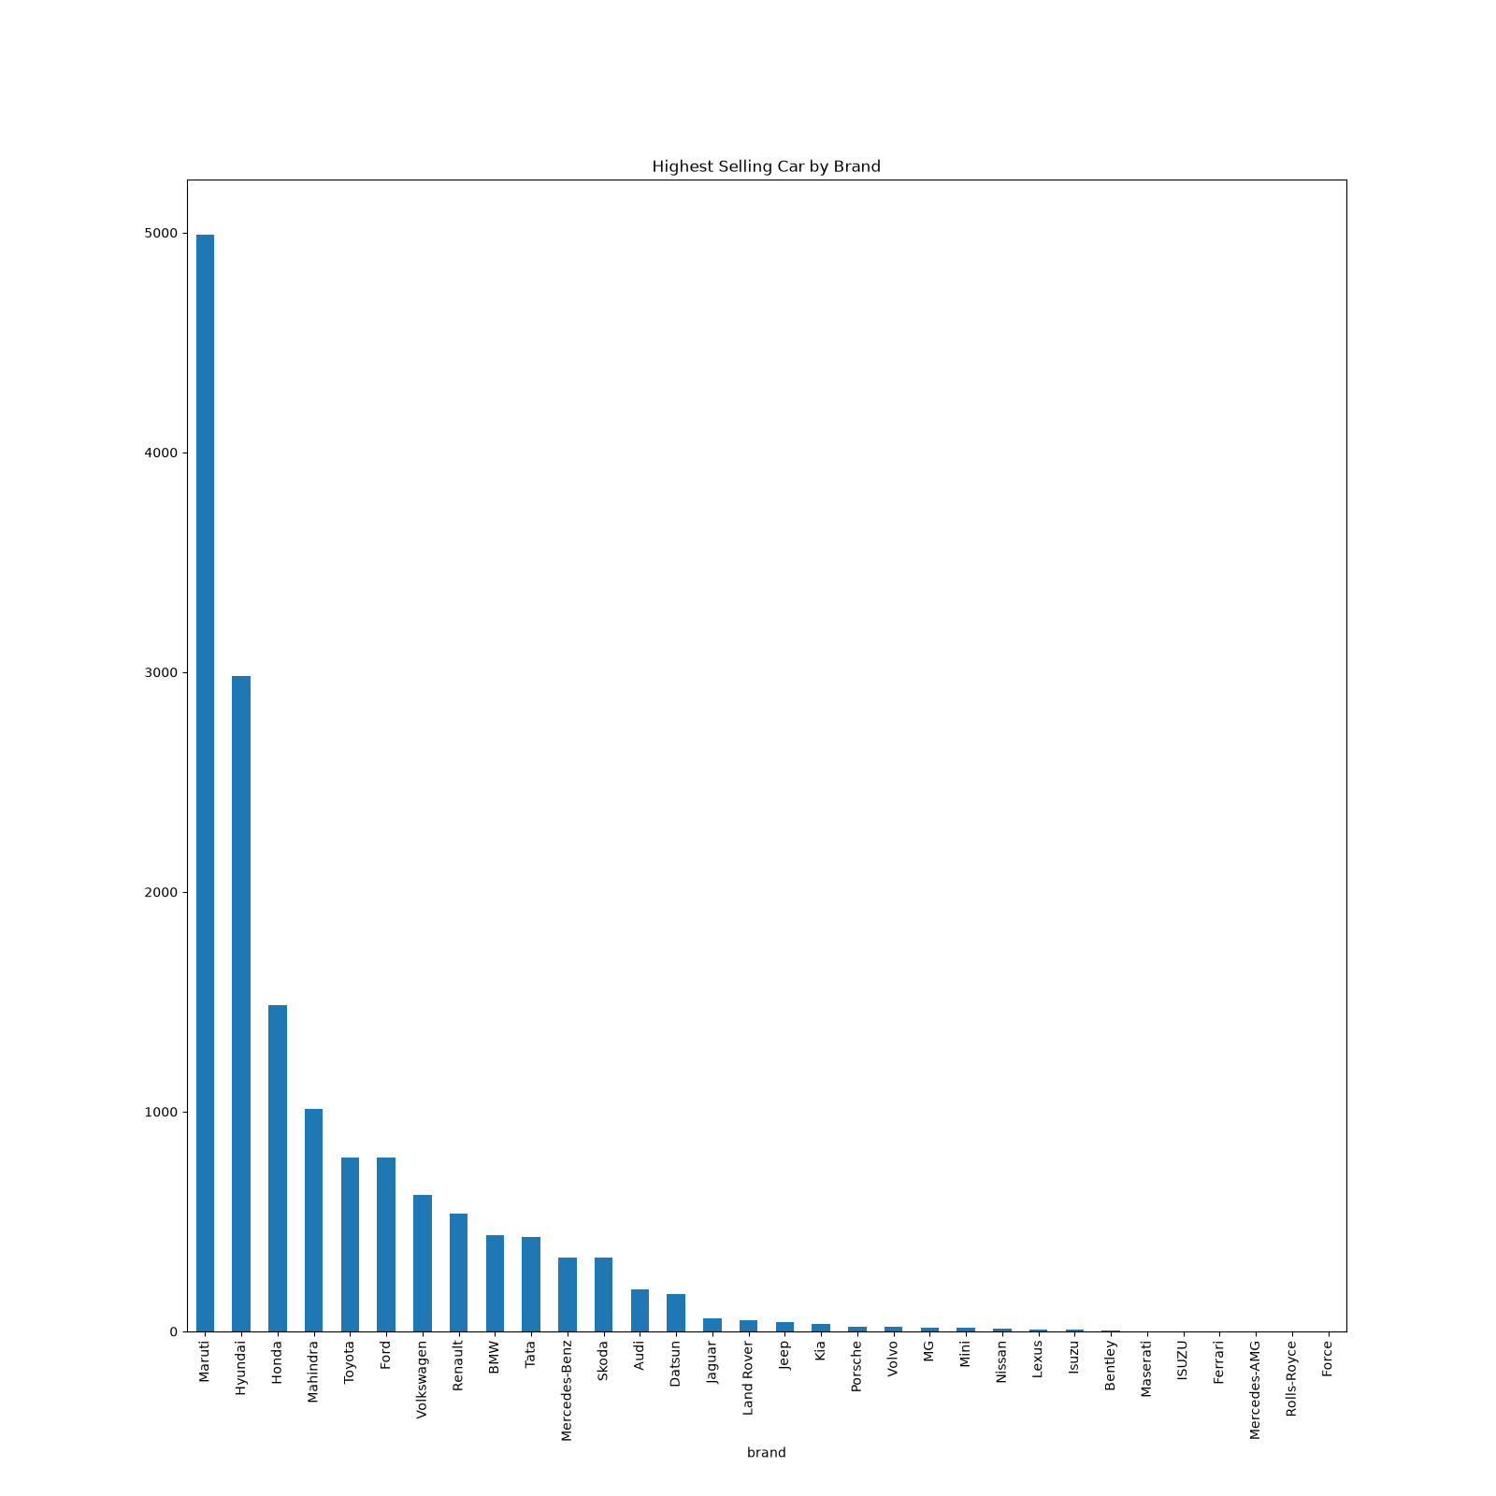
Highest selling by brand
.
.

Slide 7
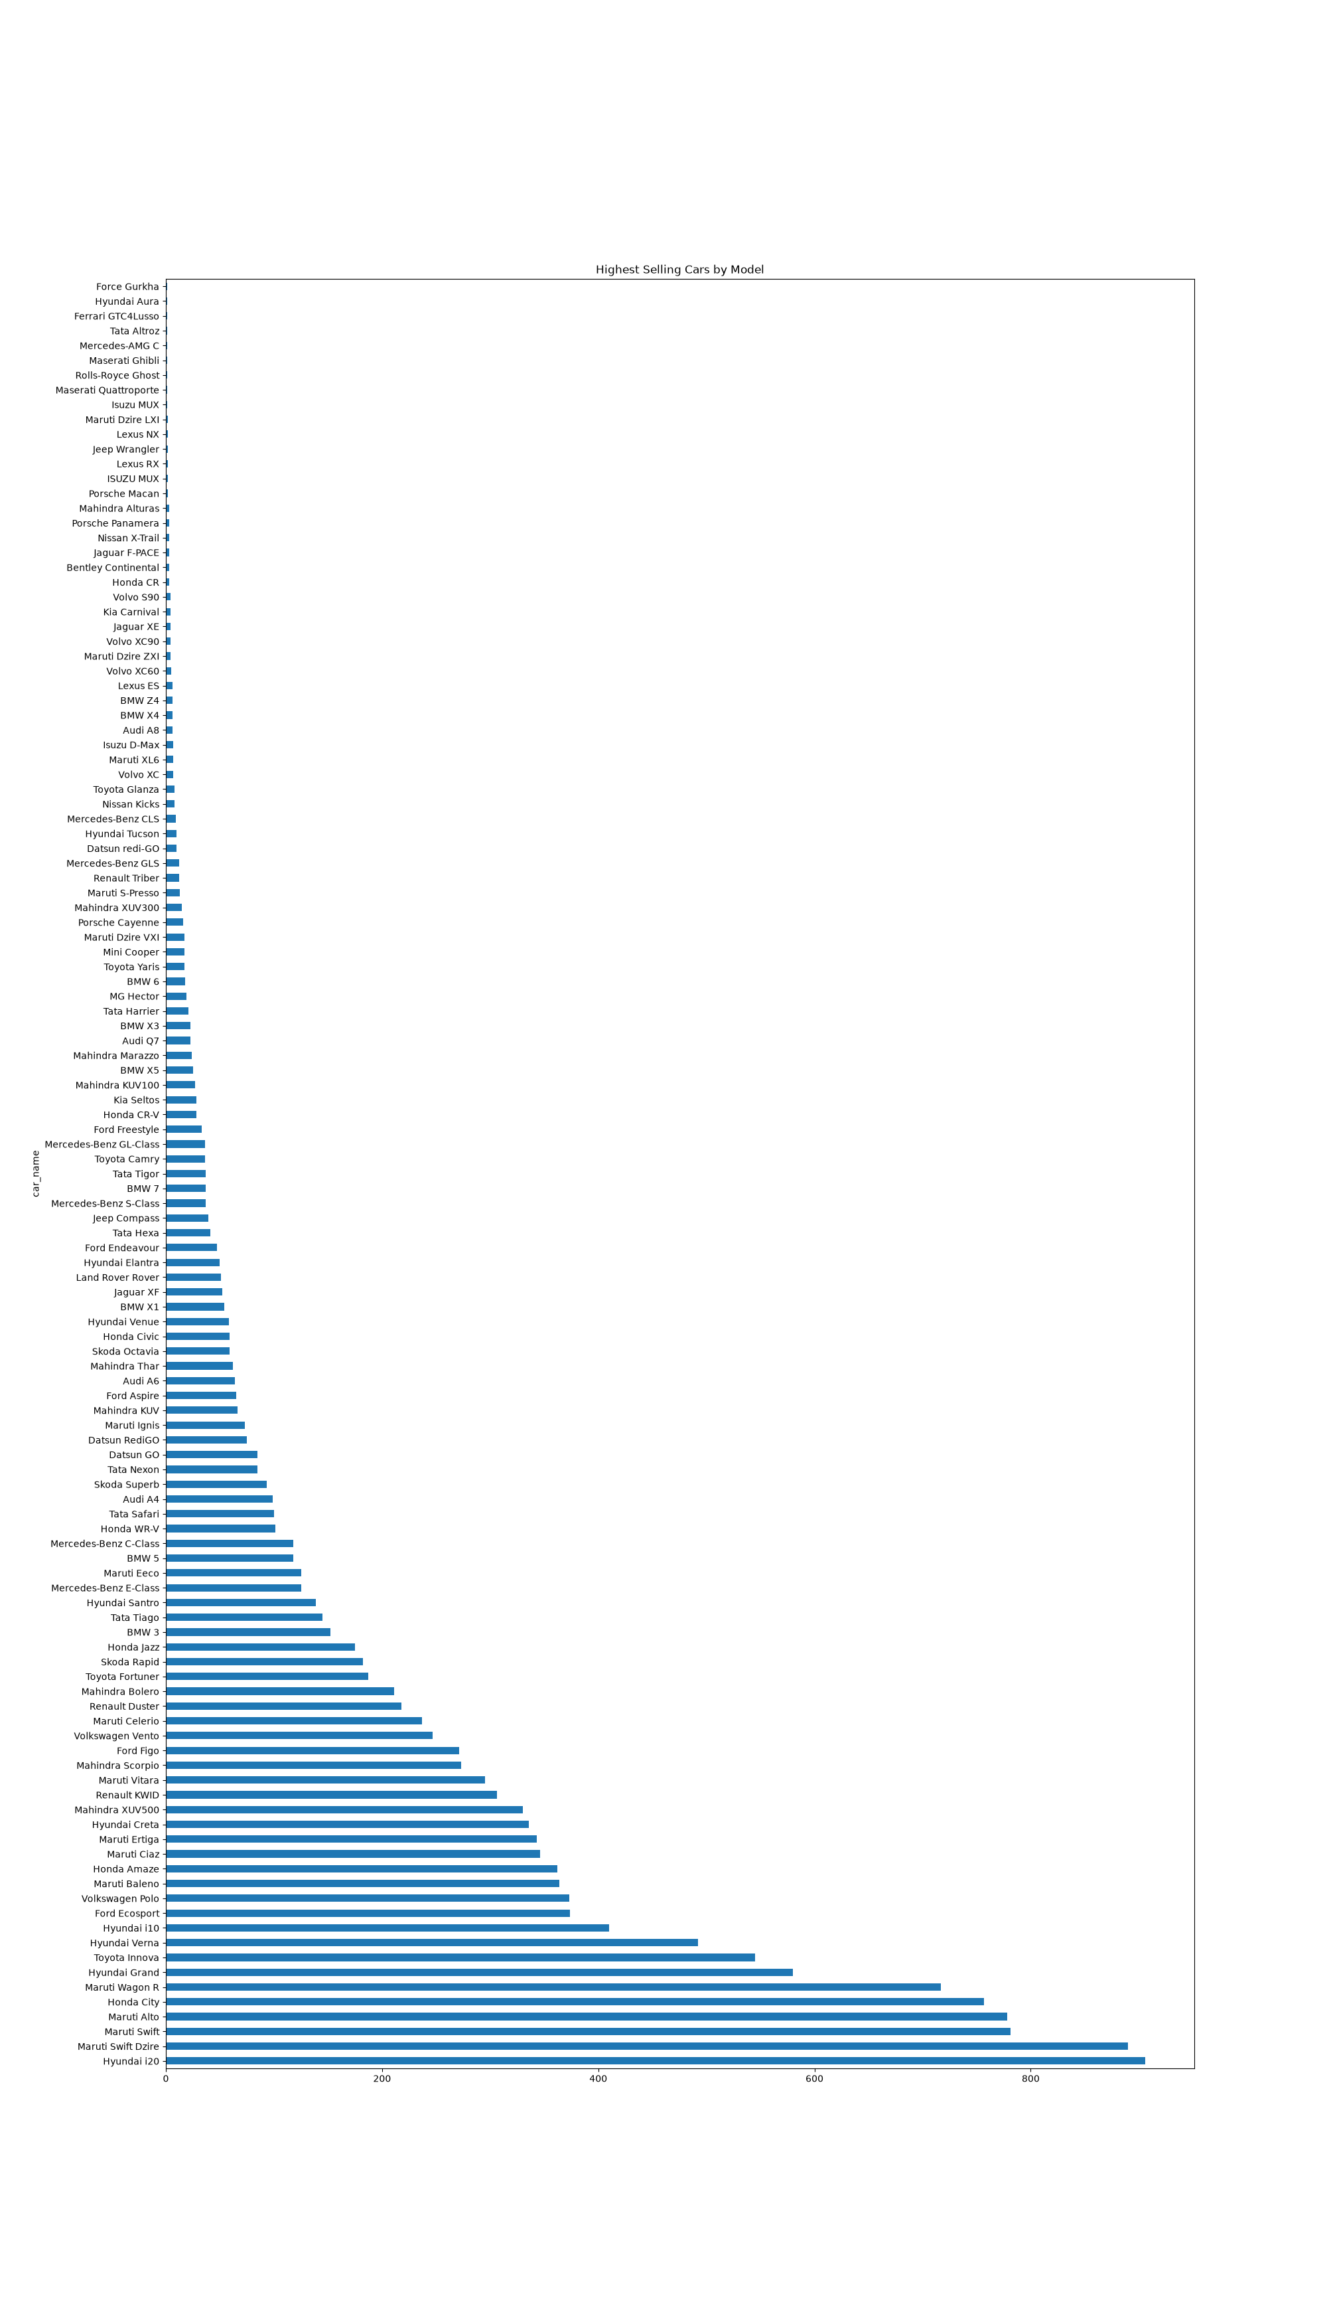
Highest selling by Model
.
.

Slide 8
Thank you
.
.

